Slide 1
NT2205- Cryptography
Week 4: Asymmetric Cryptography
(continues)
PhD. Ngoc-Tu Nguyen
tunn@uit.edu.vn

Slide 2
Outline
Why asymmetric cryptography?
Factoring Based Cryptography (P1)
RSA signature;
Logarithm Based Cryptography (P2)
DSA signature;
Diffie-Hellman key exchange;
ElGamal cipher
Elliptic Curve Cryptography (P3)
Some advanced cryptography system (quantum resistance)
Notes:
Cipher=a secret system of writing;

Slide 3
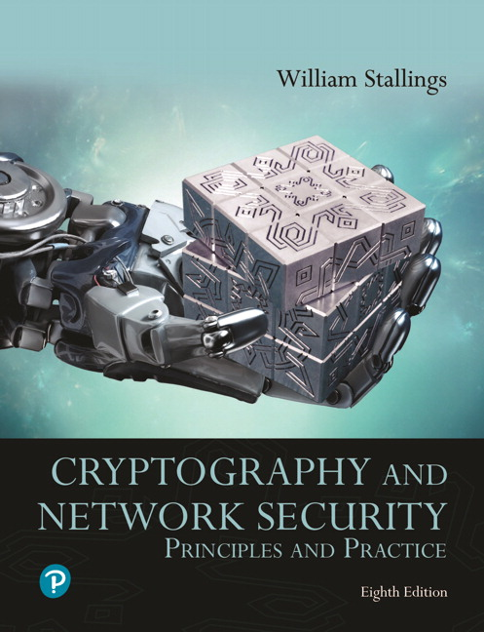
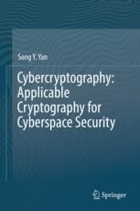
Textbooks and References
Text books
[1] Chapter 9,10
[2] Chapter 5,6,7

Slide 4
Applications of Public-Key Crypto
Encryption for confidentiality
Anyone can encrypt a message using public key;
Only someone who knows the private key can decrypt;
Secret keys are only stored in one place;
Digital signatures for authentication
Only someone who knows the private key can sign;
Anyone can verify the signature using public key;
Session key establishment
Exchange messages to create a secret session key
Then switch to symmetric cryptography (why?)

Slide 5
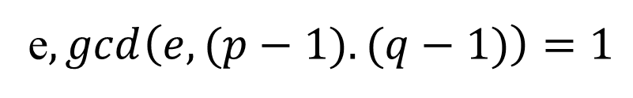
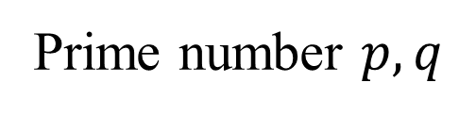

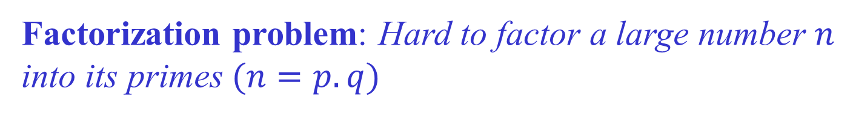
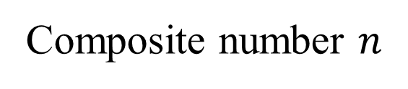
Factorization problem (review)
Hardness assumption (One-way function)
Factorization problem: Hard to factor a large number $n$
into $\text{its} \text{primes} (n=p.q)$
Easy to
compute
Prime number $p,q$
e$,gcd\left(e,(p−1).(q−1)\right)=1$
“Hard”
to compute
Composite number $n$
$$e$$

Slide 6

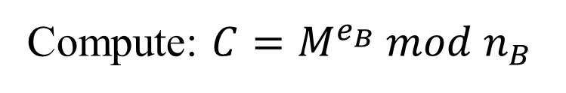
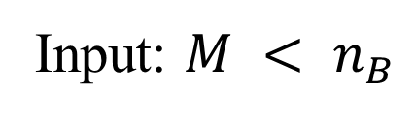


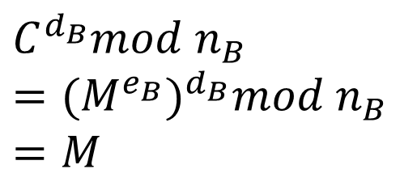
The R S A review
Alice
public key
Bob
public key
?
public key
private key
$$PU_{B}=e_{B},n_{B}$$
$$(PU_{B}=e_{B},n_{B},PR_{B}=d_{B})$$
Input: $M < n_{B}$
$$C=M^{e_{B}}$$
Compute: $C=M^{e_{B}} mod n_{B}$
Compute:
$$C^{d_{B}}mod n_{B}$$
$$={{(M}^{e_{B}})}^{d_{B}}mod n_{B}$$
$$=M$$

Slide 7
Integrity in RSA Encryption
“Textbook” RSA does not provide integrity
Given encryptions of m₁ and m₂, attacker can create encryption of m₁⋅m₂
(m₁e) ⋅ (m₂e) mod n ≡ (m₁⋅m₂)^{e} mod n
Attacker can convert m into m^{k} without decrypting
(m^{e})^{k} mod n ≡ (m^{k})^{e} mod n
In practice, OAEP is used: instead of encrypting M,
https://nvlpubs.nist.gov/nistpubs/SpecialPublications/NIST.SP.800-56Br2.pdf
Resulting encryption is plaintext-aware: infeasible to compute a valid encryption without knowing plaintext
if hash functions are “good” and RSA problem is hard

Slide 8
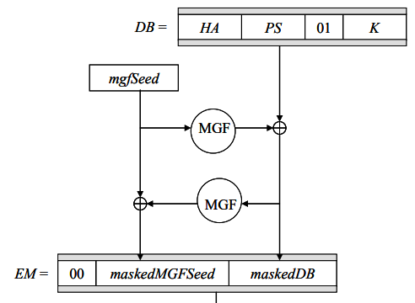
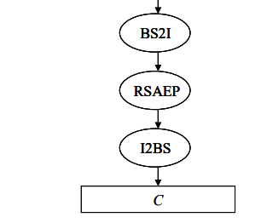
OAEP Padding in RSA Encryption
00…
Random
message
hash function

Slide 9
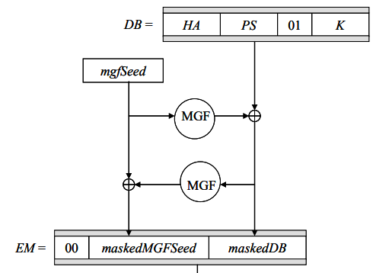
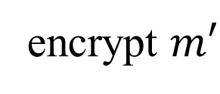
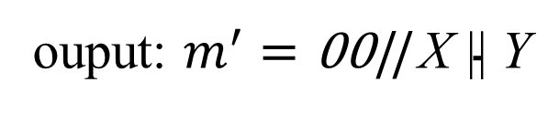
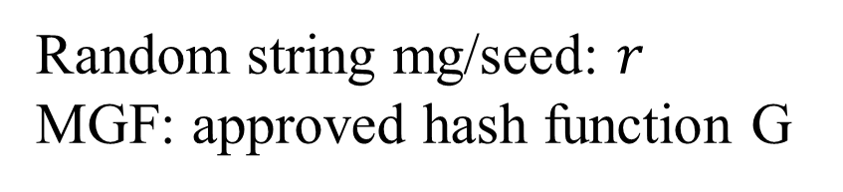

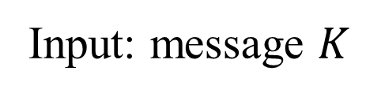
OAEP Padding in RSA Encryption
Input: message $K$
$$DB=H(A)||0000.. ||01||K$$
Random string mg/seed: $r$
MGF: approved hash function G
Y = G(r) ⊕ DB
X= G(Y) ⊕ r
ouput: $m^{′}=\text{00|| }\text{X}\text{ || }\text{Y}$
X
Y
G and H are hash functions
encrypt $m′$

Slide 10
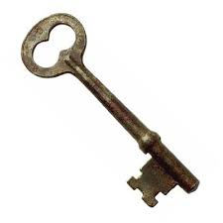


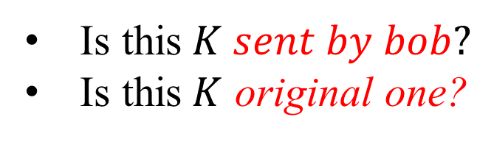

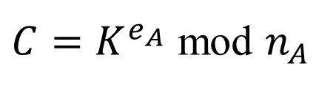
Authentication motivation
Alice
Bob
$$AES key=K$$
$$(PU_{A}=e_{A},n_{A},PR_{A}=d_{A})$$
$$PU_{A}=e_{A},n_{A}$$
$C=K^{e_{A}}$ mod $n_{A}$
$$C^{d_{A}}mod{ n}_{A}={{(K}^{e_{A}})}^{d_{A}} mod{ n}_{A}=K$$
Is this$K sent by bob?$
Is this$K$ original one?

Slide 11

Digital Signatures: Basic Idea
public key
public key
?
public key
private key
Alice
$$m, tag=tag(m,sk)$$
Bob
Given: Everybody knows Bob’s public key
Only Bob knows the corresponding private key
Goal: Bob sends a “digitally signed” message
To compute a signature, must know the private key
To verify a signature, only the public key is needed

Slide 12
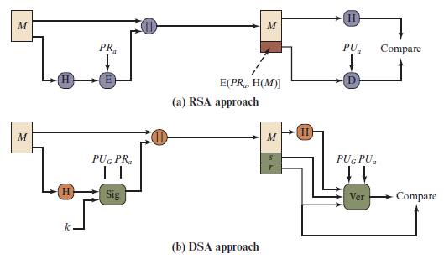
Two Approaches to Digital Signatures
Notes:
The DSA uses an algorithm that is designed to provide only the digital signature
function. Unlike RSA, it cannot be used for encryption or key exchange.
Nevertheless, it is a public-key technique.
Figure 13.2 contrasts the DSA approach for generating digital signatures to
that used with RSA. In the RSA approach, the message to be signed is input to a
hash function that produces a secure hash code of fixed length. This hash code is
then encrypted using the sender’s private key to form the signature. Both the message
and the signature are then transmitted. The recipient takes the message and
produces a hash code. The recipient also decrypts the signature using the sender’s
public key. If the calculated hash code matches the decrypted signature, the signature
is accepted as valid. Because only the sender knows the private key, only the
sender could have produced a valid signature.
The DSA approach also makes use of a hash function. The hash code is provided
as input to a signature function along with a random number k generated
for this particular signature. The signature function also depends on the sender’s
private key (PR_{a} ) and a set of parameters known to a group of communicating principals.
We can consider this set to constitute a global public key (PU_{G} ). The result
is a signature consisting of two components, labeled s and r .
At the receiving end, the hash code of the incoming message is generated. This
plus the signature is input to a verification function. The verification function also
depends on the global public key as well as the sender’s public key (PU_{a} ), which
is paired with the sender’s private key. The output of the verification function is a
value that is equal to the signature component r if the signature is valid. The signature
function is such that only the sender, with knowledge of the private key, could
have produced the valid signature.

Slide 13
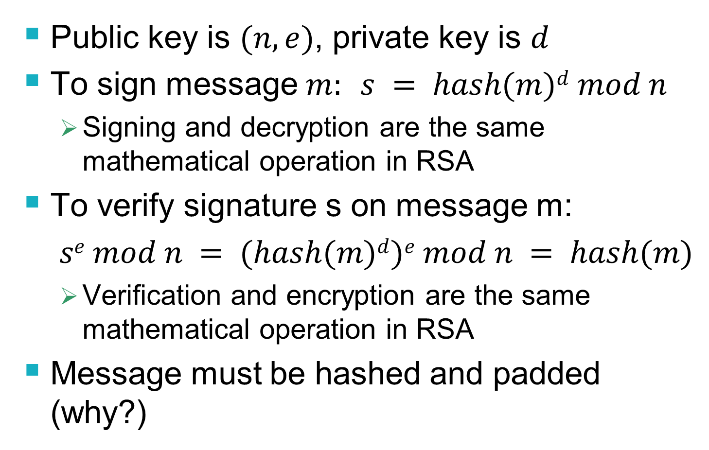
RSA Signatures
Public key is $(n,e)$, private key is $d$
To sign message $m:$ $s = hash(m)d mod n$
Signing and decryption are the same mathematical operation in RSA
To verify signature s on message m:
$se mod n = (hash(m)d)e mod n = hash(m)$
Verification and encryption are the same mathematical operation in RSA
Message must be hashed and padded (why?)

Slide 14
Outline
Why asymmetric cryptography?
Factoring Based Cryptography (P1)
RSA signature;
Logarithm Based Cryptography (P2)
DSA signature;
Diffie-Hellman key exchange;
ElGamal cipher
Elliptic Curve Cryptography (P3)
Some advanced cryptography system (quantum resistance)
Notes:
Cipher=a secret system of writing;

Slide 15

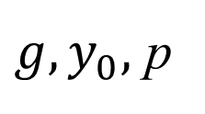

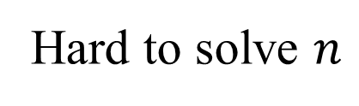
Discrete Logarithm problem
$$Finitemultiplicative group \left(G, .\right)=<g> =\{g^{n}:n∈ ℤ\}$$
Example: $G=ℤ_{p}\backslash \{0\}= \left\{1,2,…,p−1\right\}=<g>$
Easy to compute
$$y_{0}=g^{n} mod p$$
$$g, n$$
Hard to solve $n$
${g, y}_{0},$ p
$$g^{n}=y_{0} mod p$$
Hard to solve equation $g^{x}=a mod p in finite filed!$

Slide 16
N I S T Digital Signature Algorithm
Published by N I S T as Federal Information Processing Standard F I P S 186
Makes use of the Secure Hash Algorithm (S H A)
The latest version, F I P S 186-4 (2013)
https://nvlpubs.nist.gov/nistpubs/FIPS/NIST.FIPS.186-4.pdf

Slide 17
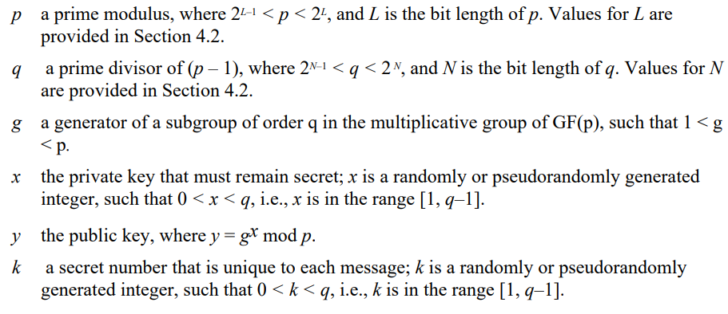
The Digital Signature Algorithm (D S A)
DSA Parameters
Notes:
The DSA is based on the difficulty of computing discrete logarithms (see Chapter 2)
and is based on schemes originally presented by Elgamal [ELGA85] and Schnorr
[SCHN91].
Figure 13.3 summarizes the algorithm.
There are three parameters that are public and can be common to a group of users. An N-bit prime number q is chosen. Next, a prime number p is selected with a length between 512 and 1024 bits such that q divides (p - 1). Finally, g is chosen to be of the form h^{(p-1)/q} mod p, where h is an integer between 1 and (p - 1) with the restriction that g must be greater than 1. Thus, the global public-key components of DSA are the same as in the Schnorr sig- nature scheme.
With these parameters in hand, each user selects a private key and generates a public key. The private key x must be a number from 1 to (q - 1) and should be chosen randomly or pseudorandomly. The public key is calculated from the private key as y = g^{x} mod p. The calculation of y given x is relatively straight- forward. However, given the public key y, it is believed to be computationally infeasible to determine x, which is the discrete logarithm of y to the base g, mod p (see Chapter 2).
The signature of a message M consists of the pair of numbers r and s, which are functions of the public key components (p, q, g), the user’s private key (x), the hash code of the message H(M), and an additional integer k that should be generated randomly or pseudorandomly and be unique for each signing.
Let M, r′, and s′ be the received versions of M, r, and s, respectively. Verification is performed using the formulas shown in Figure 13.3. The receiver generates a quantity v that is a function of the public key components, the sender’s public key, the hash code of the incoming message, and the received versions of r and s. If this quantity matches the r component of the signature, then the signature is validated.

Slide 18
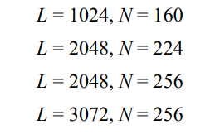
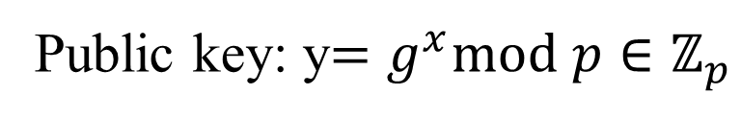
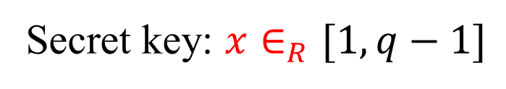



The Digital Signature Algorithm (D S A)
DSA Parameters
$2^{L−1}<p<2^{L}, p−1⋮q$
$2^{N−1}<q<2^{N}$
$$\left\langle g\right\rangle =GF\left(p\right)=ℤ_{p}$$
$$H:{\left\{0,1\right\}}^{∗}→{\left\{0,1\right\}}^{l};l≤min⁡(L,N)$$
Key generation (for signer)
Secret key: $x∈_{R}[1,q−1]$
Public key: y$=g^{x}mod p∈ℤ_{p}$
Notes:
The DSA is based on the difficulty of computing discrete logarithms (see Chapter 2)
and is based on schemes originally presented by Elgamal [ELGA85] and Schnorr
[SCHN91].
Figure 13.3 summarizes the algorithm.
There are three parameters that are public and can be common to a group of users. An N-bit prime number q is chosen. Next, a prime number p is selected with a length between 512 and 1024 bits such that q divides (p - 1). Finally, g is chosen to be of the form h^{(p-1)/q} mod p, where h is an integer between 1 and (p - 1) with the restriction that g must be greater than 1. Thus, the global public-key components of DSA are the same as in the Schnorr sig- nature scheme.
With these parameters in hand, each user selects a private key and generates a public key. The private key x must be a number from 1 to (q - 1) and should be chosen randomly or pseudorandomly. The public key is calculated from the private key as y = g^{x} mod p. The calculation of y given x is relatively straight- forward. However, given the public key y, it is believed to be computationally infeasible to determine x, which is the discrete logarithm of y to the base g, mod p (see Chapter 2).
The signature of a message M consists of the pair of numbers r and s, which are functions of the public key components (p, q, g), the user’s private key (x), the hash code of the message H(M), and an additional integer k that should be generated randomly or pseudorandomly and be unique for each signing.
Let M, r′, and s′ be the received versions of M, r, and s, respectively. Verification is performed using the formulas shown in Figure 13.3. The receiver generates a quantity v that is a function of the public key components, the sender’s public key, the hash code of the incoming message, and the received versions of r and s. If this quantity matches the r component of the signature, then the signature is validated.

Slide 19
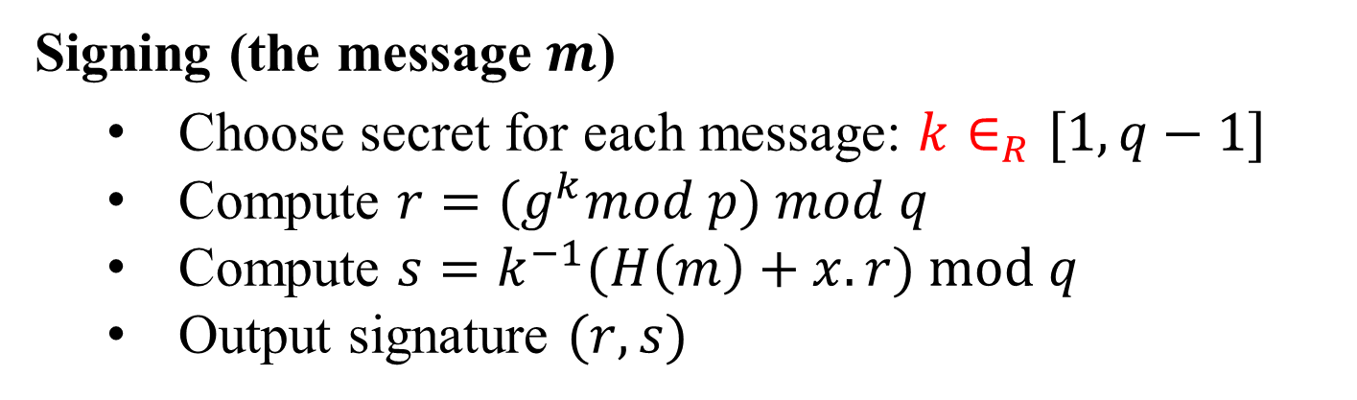
The Digital Signature Algorithm (D S A)
Signing (the message $m$)
Choose secret for each message: $k∈_{R}[1,q−1]$
Compute $r={(g}^{k}mod p) mod q$
Compute $s=k^{−1}(H\left(m\right)+x.r) mod q$
Output signature $(r,s)$

Slide 20
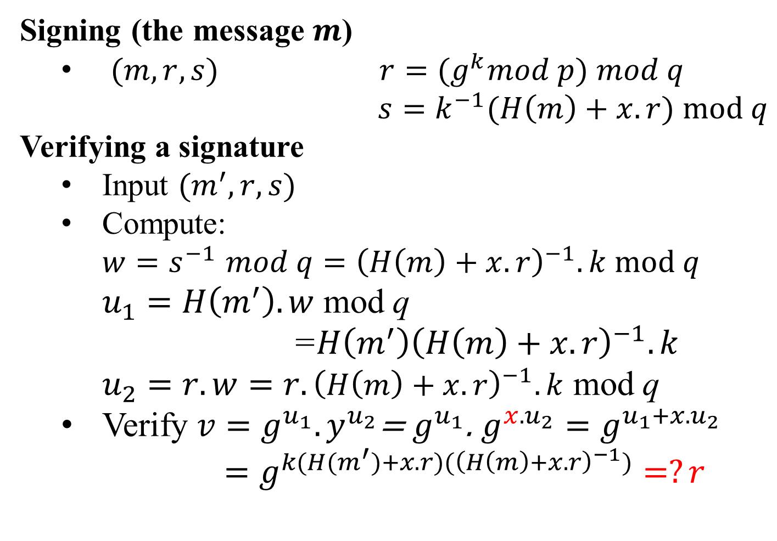
The Digital Signature Algorithm (D S A)
Signing (the message $m$)
$(m, r,s)$ $r={(g}^{k}mod p) mod q$
$s=k^{−1}(H\left(m\right)+x.r) mod q$
Verifying a signature
Input $(m^{′},r,s)$
Compute:
$w{=s}^{−1}mod q={\left(H\left(m\right)+x.r\right)}^{−1}.k mod q$
$u_{1}=H\left(m^{′}\right).w$ mod q
=${H\left(m^{′}\right)\left(H\left(m\right)+x.r\right)}^{−1}.k$
$u_{2}=r.w=r.{\left(H\left(m\right)+x.r\right)}^{−1}.k$ mod q
Verify $v=g^{u_{1}}.y^{u_{2}}$= $g^{u_{1}}$. $g^{{x.u}_{2}}=g^{u_{1}+x.u_{2}}$
$=g^{k(H(m^{′})+x.r)({\left(H\left(m\right)+x.r\right)}^{−1})}=?r$

Slide 21
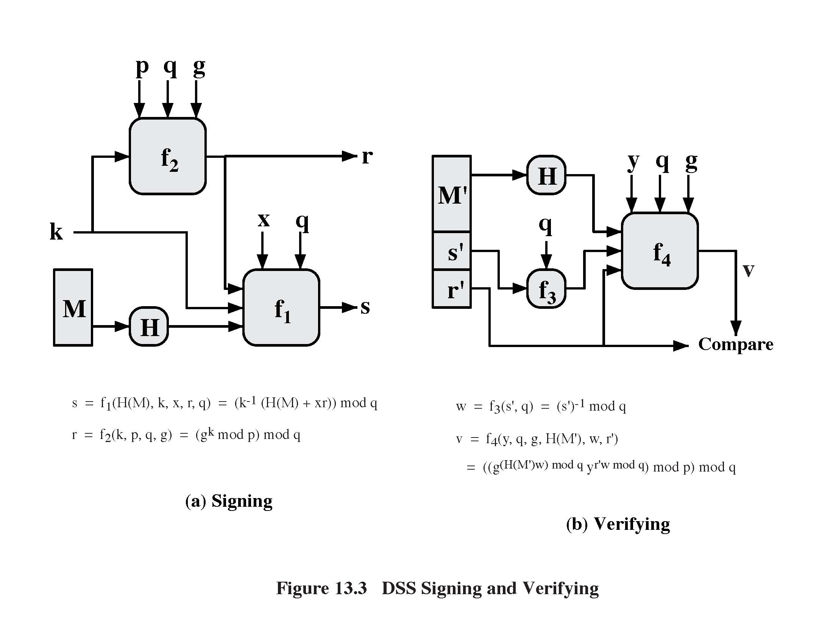
DSA: Signing a Message
r = (g^{k} mod p) mod q
Private key
Random secret
between 0 and q
(r,s) is the
signature on M
Message
Hash function
(SHA-1)
s = k⁻¹⋅(H(M)+x⋅r) mod q

Slide 22
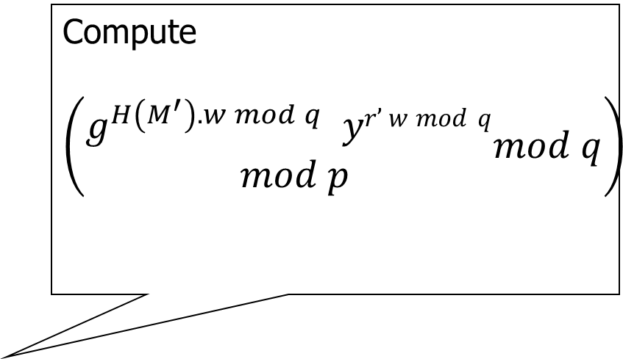
DSA: Verifying a Signature
Compute
$$\left(\begin{aligned}g^{H\left(M^{′}\right).w mod q } yr’ w mod q \\ mod p\end{aligned}mod q\right)$$
Public key
Message
Signature
w = s’⁻¹ mod q
If they match, signature is valid

Slide 23
Security of DSA
Can’t create a valid signature without private key
Can’t change or tamper with signed message
If the same message is signed twice, signatures are different
Each signature is based in part on random secret k
Secret k must be different for each signature!
If k is leaked or if two messages re-use the same k, attacker can recover secret key x and forge any signature from then on

Slide 24
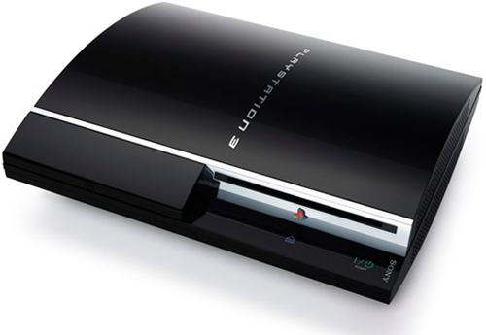

PS3 Epic Fail
Sony uses ECDSA algorithm to sign authorized software for Playstation 3
Basically, DSA based on elliptic curves
… with the same random value in every signature
Trivial to extract master signing key and sign any homebrew software – perfect “jailbreak” for PS3
Announced by George “Geohot” Hotz
and Fail0verflow team in Dec 2010
Q: Why didn’t Sony just revoke the key?

Slide 25
Diffie-Hellman key exchange
Alice and Bob never met and share no secrets
Public info: p and g
p is a large prime number, g is a generator of Z_{p}*
Z_{p}*={1, 2 … p-1}; ∀a∈Z_{p}* ∃i such that a=g^{i} mod p
Pick secret, random x
Pick secret, random y
g^{x} mod p
g^{y} mod p
Alice
Bob
Compute k=(g^{y})^{x}=g^{xy} mod p
Compute k=(g^{x})^{y}=g^{xy} mod p

Slide 26
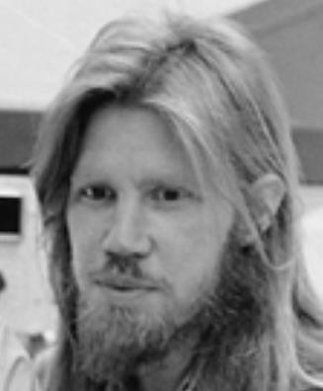
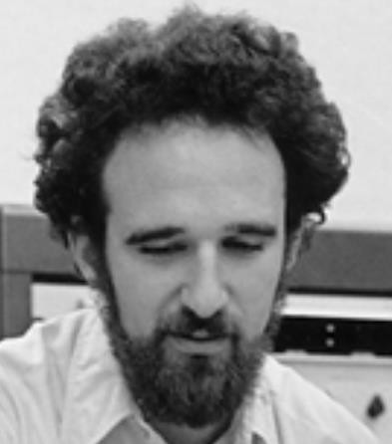
Diffie-Hellman Protocol
p = 1606938044258990275541962092341162602522202993782792835301301
𝑔 = 123456789
𝑔^{𝑎} mod p = 78467374529422653579754596319852702575499692980085777948593
560048104293218128667441021342483133802626271394299410128798 = 𝑔^{𝑏} mod p
𝑎 =
685408003627063
761059275919665
781694368639459
527871881531452
𝑏 =
362059131912941
987637880257325
269696682836735
524942246807440
𝑔^{𝑎𝑏} mod p = 437452857085801785219961443000845969831329749878767465041215

Slide 27
Why Is Diffie-Hellman Secure?
Discrete Logarithm (DL) problem:
given g^{x} mod p, it’s hard to extract x
There is no known efficient algorithm for doing this
This is not enough for Diffie-Hellman to be secure!
Computational Diffie-Hellman (CDH) problem:
given g^{x} and g^{y}, it’s hard to compute g^{xy} mod p
… unless you know x or y, in which case it’s easy
Decisional Diffie-Hellman (DDH) problem:
given g^{x} and g^{y}, it’s hard to tell the difference between g^{xy} mod p and g^{r} mod p where r is random

Slide 28
Properties of Diffie-Hellman
Assuming DDH problem is hard, Diffie-Hellman protocol is a secure key establishment protocol against passive attackers
Eavesdropper can’t tell the difference between the established key and a random value
Can use the new key for symmetric cryptography
Basic Diffie-Hellman protocol does not provide authentication
IPsec combines Diffie-Hellman with signatures, anti-DoS cookies, etc.

Slide 29
Outline
Why asymmetric cryptography?
Factoring Based Cryptography (P1)
RSA signature;
Logarithm Based Cryptography (P2)
DSA signature;
Diffie-Hellman key exchange;
ElGamal cipher
Elliptic Curve Cryptography (P3)
Some advanced cryptography system (quantum resistance)
Notes:
Cipher=a secret system of writing;

Slide 30
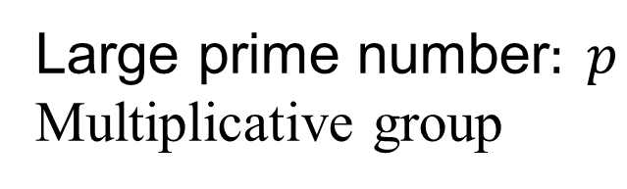
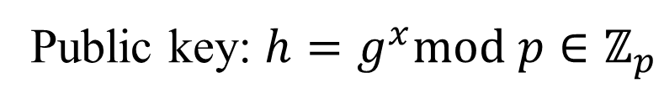
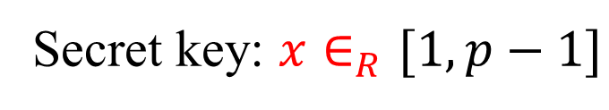
ElGamal cipher
ElGamal parameters
Large prime number$: p$
Multiplicative group
$$G=\left\langle g\right\rangle =ℤ_{p}\backslash \{0\}=\{1,2,…, p−1\}$$
Key generation (
Secret key: $x∈_{R}[1,p−1]$
Public key: $h=g^{x}mod p∈ℤ_{p}$
Notes:
The DSA is based on the difficulty of computing discrete logarithms (see Chapter 2)
and is based on schemes originally presented by Elgamal [ELGA85] and Schnorr
[SCHN91].
Figure 13.3 summarizes the algorithm.
There are three parameters that are public and can be common to a group of users. An N-bit prime number q is chosen. Next, a prime number p is selected with a length between 512 and 1024 bits such that q divides (p - 1). Finally, g is chosen to be of the form h^{(p-1)/q} mod p, where h is an integer between 1 and (p - 1) with the restriction that g must be greater than 1. Thus, the global public-key components of DSA are the same as in the Schnorr sig- nature scheme.
With these parameters in hand, each user selects a private key and generates a public key. The private key x must be a number from 1 to (q - 1) and should be chosen randomly or pseudorandomly. The public key is calculated from the private key as y = g^{x} mod p. The calculation of y given x is relatively straight- forward. However, given the public key y, it is believed to be computationally infeasible to determine x, which is the discrete logarithm of y to the base g, mod p (see Chapter 2).
The signature of a message M consists of the pair of numbers r and s, which are functions of the public key components (p, q, g), the user’s private key (x), the hash code of the message H(M), and an additional integer k that should be generated randomly or pseudorandomly and be unique for each signing.
Let M, r′, and s′ be the received versions of M, r, and s, respectively. Verification is performed using the formulas shown in Figure 13.3. The receiver generates a quantity v that is a function of the public key components, the sender’s public key, the hash code of the incoming message, and the received versions of r and s. If this quantity matches the r component of the signature, then the signature is validated.

Slide 31
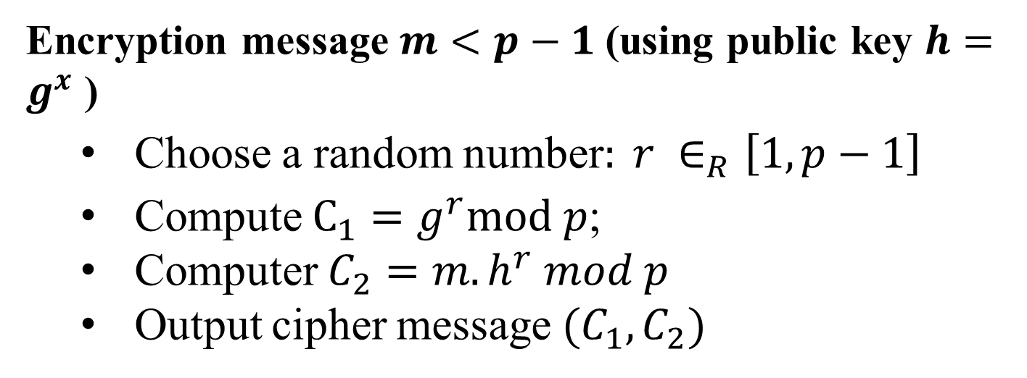
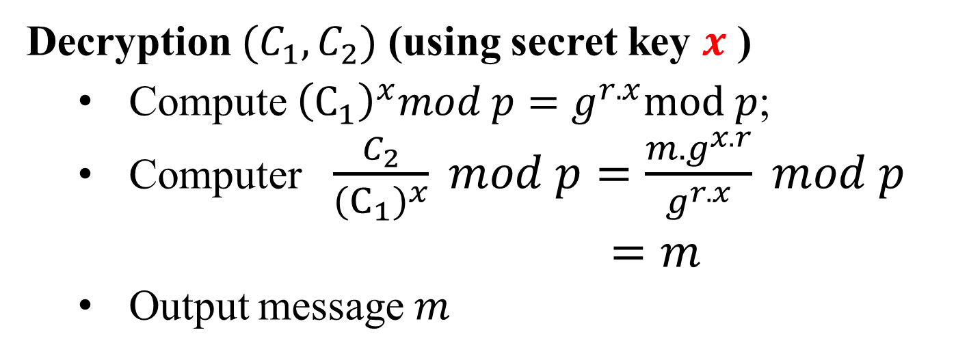
ElGamal cipher
Encryption message $m<p−1$(using public key $h=g^{x}$ )
Choose a random number$: r ∈_{R}\left[1,p−1\right]$
Compute $C_{1}=g^{r}mod p$;
Computer $C_{2}=m.h^{r} mod p$
Output cipher message $(C_{1},C_{2})$
Decryption $(C_{1},C_{2})$ (using secret key $x$ )
Compute ${\left(C_{1}\right)}^{x}mod p=g^{r.x}mod p$;
Computer $\frac{C_{2}}{{\left(C_{1}\right)}^{x}} mod p=\frac{m.g^{x.r}}{g^{r.x}} mod p$
$=m$
Output message $m$

Slide 32

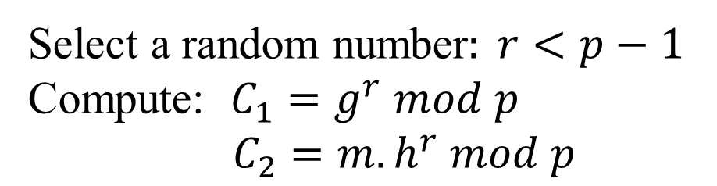
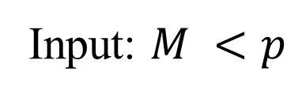


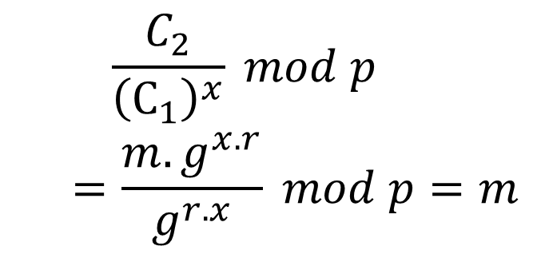
ElGamal cipher
Alice
public key
Bob
public key
?
public key
private key
$$PU_{B}=h,p$$
$$(PU_{B}={h=g}^{x},p,PR_{B}=x)$$
Input: $M <p$
$${(C}_{1},C_{2})$$
Select a random number$: r<p−1$
Compute: $C_{1}=g^{r} mod p$
$C_{2}=m.h^{r} mod p$
Compute:
$$\frac{C_{2}}{{\left(C_{1}\right)}^{x}} mod p$$
$$=\frac{m.g^{x.r}}{g^{r.x}} mod p=m$$

Slide 33
Advantages of Public-Key Crypto
Confidentiality without shared secrets
Very useful in open environments
Can use this for key establishment, avoiding the “chicken-or-egg” problem
With symmetric crypto, two parties must share a secret before they can exchange secret messages
Authentication without shared secrets
Encryption keys are public, but must be sure that Alice’s public key is really her public key
This is a hard problem… Often solved using public-key certificates

Slide 34
Disadvantages of Public-Key Crypto
Calculations are 2-3 orders of magnitude slower
Modular exponentiation is an expensive computation
Typical usage: use public-key cryptography to establish a shared secret, then switch to symmetric crypto
SSL, IPsec, most other systems based on public crypto
Keys are longer
2048 bits (RSA) rather than 128 bits (AES)
Relies on unproven number-theoretic assumptions
Factoring, RSA problem, discrete logarithm problem, decisional Diffie-Hellman problem…

